Slide 1
Topic 2C: Claims - Scope of Protection and Search
Lutz Mailänder
Head, International Cooperation on Examination and Training Section
Teheran
December 17, 2019

Slide 2
Agenda
Types of claims
Unity of patents
Claims evolution

Slide 3
What is a patent claim?
A patent provides protection for an invention, i.e. the invention cannot be used by others for commercial purposes without permission of the owner
An invention offers a technical solution to a problem
Each invention can be defined
by the features that are essential
to solve the problem
Main claim includes these features
Claim 1
Invention
Feature A
Feature B
Feature C
Feature D
Feature A
Feature B
Feature C
Feature D

Slide 4
Claim sample – as filed
A method of producing a soya bean product, the method including the step of exposing soya beans to an acidic aqueous solution.
A method as claimed in Claim 1, in which the acidic aqueous solution has a pH of between about 2,0 and 5,5.
A method as claimed in Claim 1 or Claim 2, in which the soya beans are whole beans.
A method as claimed in any one of the preceding claims, which includes the prior step of dissolving an organic acid in water to produce the aqueous acidic solution.
A method as claimed in Claim 4, in which the organic acid is citric acid.
WO2005055733

Slide 5
Claim sample – as filed
1. A method of determining the torque induced in a rotating shaft (51),
A the shaft (51) having a torsional oscillation frequency that is dependent on the stiffness of the shaft (51),
B where the torsional oscillation frequency and the stiffness are dependent upon the operating conditions of the shaft (51),
characterized in that
C the torsional oscillation frequency of the rotating shaft (51) is measured (35);
D the twist induced in the rotating shaft (51) by the torque is measured (39); and
E the measured value of the torsional oscillation frequency and the measured value of the induced twist are used (41) to determine the torque induced in the shaft (51).
Notes:
One part claim

Slide 6
Clarity of claims
Clarity of claims has two aspects
Claims define the scope of protection
  In case of litigations, claim wording should not permit ambiguous interpretation
  Patent laws require claims to be clear and concise
  > Principle of Legal Certainty
Only subject matter described in claims is examined for novelty and inventive step
Claims therefore determine the scope of the prior art search
Meaningful search is not possible without clear claims
Searching authorities may decline searches in such cases
Notes:
Two aspects to clarity:
Add ref to law

Slide 7
Clarity of claims
Claims are often not easily comprehensible
  Requirement of 'Clarity' does not mean easy comprehensibility
  Claims are always worded in a rather abstract way; usually as one sentence with heavy punctuation
  Need not be self explanatory; description and drawings are used to interpret the claims
Notes:
Two aspects to clarity

Slide 8
Categories of claims
Two categories of claims according to the two categories of inventions:
  Claims for methods, processes (intangible)
  Claims for products (tangible)
    Devices, apparatus, compositions,…
Notes:
8

Slide 9
Types of claims
Independent claims
  One part claims
  Two part claims
Dependent claims
Notes:
9

Slide 10
Sample: Main claim & dependent claims
A method of producing a soya bean product, the method including the step of exposing soya beans to an acidic aqueous solution.
A method as claimed in Claim 1, in which the acidic aqueous solution has a pH of between about 2,0 and 5,5.
A method as claimed in Claim 1 or Claim 2, in which the soya beans are whole beans.
A method as claimed in any one of the preceding claims, which includes the prior step of dissolving an organic acid in water to produce the aqueous acidic solution.
Claims 2-4 are dependent claims since they refer to claim 1.
WO2005055733

Slide 11
Dependent claims
A dependent claim refers to at least one other claim, e.g.
  2. Apparatus according claim 1 where ….
  3. Apparatus according claim 1 or 2 where …….
  6. Apparatus according claim 1 and 2 where …….
  7. Apparatus according any of the preceding claims where ….
By way of reference the features/elements of the referenced claim(s) are included, i.e. combined with the other features/elements
References are therefore admissible only to claims of same category (method, product)
Notes:
Multidependent claims

Slide 12
Inclusion by reference
1. Apparatus with A, B, C
2. Apparatus according to claim 1 where D
= 2. Apparatus with A, B, C, D
3. Apparatus according to claim 1 and 2 where E
= 3. Apparatus with A, B, C, D, E
  4. Apparatus according to claim 1 or 2 where E
  = 4. Apparatus with A, B, C, E
  + 5. Apparatus with A, B, C, D, E
Notes:
Multidependent claims

Slide 13
Why dependent and independent claims?
Main claim (1st independent claim):
Includes all the features/elements of the invention
which are essential to solve the problem,
and only those features!
“1. Apparatus/process with {feature A}, {feature B}, {feature C}, {feature D}.”
Dependent claims:
additional or optional features which are not essential but describe options for various embodiments, or for additional advantages
Invention
Feature A
Feature B
Feature C
Feature D
EP 2006651 B1
Notes:
13

Slide 14
Why several independent claims?
Further independent claims for
Two categories: product and process
Alternative similar solutions for same problem linked through the same inventive concept
(unity of invention!)
Invention
Feature A
Feature B
Feature C
Feature E
EP 2006651 B1
Notes:
14

Slide 15
Unity of patents
Unity of patents: Claiming of several distinct inventions in one application is not admissible, i.e. solutions to distinct problems
Applicants should not get protection for 2 inventions while paying only fees for one application!
Several independent claims could, for example, define different inventions
Several independent claims may, however, as well define related inventive subject matter, e.g.
  a product if 1st claim is process, or vice versa
  a specially adapted apparatus to carry out the process

Slide 16
Unity of patents
Unity is usually checked only with respect to claimed subject matter, i.e. either
  If an application includes several independent claims, or
  If an independent (main) claim includes two distinct claimed subject matters, e.g. when certain features are presented as alternatives, i.e. 'A' or 'B'
Unity of invention is no problem if the description includes several distinct inventions
Lack of unity solvable by
  Dividing the application
  Election of claims and abandonment/discontinuation of others

Slide 17
Unity of patents
Rule 604. Unity of Invention. –
(a) The application shall relate to one invention only or to a group of inventions forming a single general inventive concept (Sec. 38.1, IP Code).
(b) If several independent inventions which do not form a single general inventive concept are claimed in one application, the Director may require that the application be restricted to a single invention. ….. (by election of claims, or mandatory division)
PCT Rule 13.3; EPC Rule 42(2)

Slide 18
Unity of patents
Lack of unity may
  be directly evident 'a priori' (obvious lack of unity, prior to search; at formality examination)
  Become apparent only in comparison to prior art 'a posteriori' (i.e. after search, during substantive examination)
Unity is given 'when there is a technical relationship among the claimed inventions involving one or more of the same or corresponding special technical features'
  Unity is given as long as inventive subject matters are linked to same inventive concept, i.e. variations of solutions of same problem
PCT Rule 13.2; EPC Rule 44(1)

Slide 19
Unity of patents – generic example
(Academic) Example from PCT Examination Guidelines 10.03
Three independet claims:
  Claim 1: A + X
  Claim 2: A + Y
  Claim 3: X + Y
'A priori' lack of unity because claim 3 has nothing in common with claims 1 and 2
'A posteriori' lack of unity if search reveals that feature A which is common to Claims 1 and 2 is known; then X and Y would be special technical features describing the difference to the known prior art A, however they are distinct and have nothing in common
See further examples and discussion in the PCT Examination Guidelines

Slide 20
Claim sample - one part claim
A method of producing a soya bean product, the method including the step of exposing soya beans to an acidic aqueous solution.
Introducing part (category, purpose) (preamble)
Body of claim
WO2005055733

Slide 21
Claim sample – two part claim
Introducing part (category, purpose)
1. A method of determining the torque induced in a rotating shaft (51),
A the shaft (51) having a torsional oscillation frequency that is dependent on the stiffness of the shaft (51),
B where the torsional oscillation frequency and the stiffness are dependent upon the operating conditions of the shaft (51),
characterized in that
C the torsional oscillation frequency of the rotating shaft (51) is measured (35);
D the twist induced in the rotating shaft (51) by the torque is measured (39); and
E the measured value of the torsional oscillation frequency and the measured value of the induced twist are used (41) to determine the torque induced in the shaft (51).
generic expression
Sequence of 5 features A – E (added)
EP 2006651 A2
Notes:
One part claim

Slide 22
Types of independent claims
One part claim:
includes just list of the essential features
“1. Apparatus {with, where, comprising} A,B,C,D”
Invention
Feature A
Feature B
Feature C
Feature D
Notes:
22

Slide 23
Types of claims
Invention
Feature A
Feature B
Feature C
Feature D
Two part claim:
“1. Apparatus with A, B and C,
characterized in that D”
> first part (preamble) describes closest prior art
> second part describes difference(s) between invention and closest prior art:
> ‘special technical features’
Single
document
Closest prior art
Feature A
Feature B
Feature C
Notes:
23

Slide 24
Closest prior art
► State of the art published prior to filing/priority date
Invention
Feature A
Feature B
Feature C
Feature D
Document 1: A+B
Document 2: A+C
Document 3: A+B+C
Closest prior art
Notes:
24

Slide 25
Closest prior art ?
► State of the art published prior to filing/priority date
Invention
Feature A
Feature B
Feature C
Feature D
Document 1: A+B
Document 2: A+C
Document 3: A+B+C
Closest prior art?
Document 4: A+B+D
Closest prior art?
Document 5: B+C+D
Closest prior art?
Notes:
25

Slide 26
Potential claim wordings
Document 3 is prior art:
Apparatus with A, B and C, characterized in that D
Document 4 is prior art:
Apparatus with A, B and D, characterized in that C
Document 5 is prior art:
Apparatus with B, C and D, characterized in that A
One part claim: Apparatus with A, B, C and D.

Slide 27
Deconstruction of claim wording
Deconstruction of claim wording, i.e. structuring/sorting the subject matter of a claim into distinct features/elements facilitates:
  Understanding of the subject matter
  Checking the clarity of the claim wording
  Searching of prior art
  Assessing of novelty by comparing the distinct features with the prior art
  Determination of the closest prior art
  (Determination of the difference to the closest prior art)
  Comparison of claims subject to examination at different IPOs (claims of different members of the patent family)

Slide 28
Evolution of claims
Claims of a patent application are usually different at different publication and prosecution stages of the application
Before examination, the initially filed independent claims in applications have a broader scope because applicants seek to get as much protection as possible
Claims of granted patents are, in comparison to the initially filed claims,
  Usually narrower, i.e. include additional features, or
  May be totally different
Claims after opposition have often narrower scope than claims after grant
Notes:
Add something on differences between IPOs' pratice regarding claims. Essential and formal differences of claims granted.

Slide 29
Claim sample – as filed
1. A method of determining the torque induced in a rotating shaft (51),
A the shaft (51) having a torsional oscillation frequency that is dependent on the stiffness of the shaft (51),
B where the torsional oscillation frequency and the stiffness are dependent upon the operating conditions of the shaft (51),
characterized in that
C the torsional oscillation frequency of the rotating shaft (51) is measured (35);
D the twist induced in the rotating shaft (51) by the torque is measured (39); and
E the measured value of the torsional oscillation frequency and the measured value of the induced twist are used (41) to determine the torque induced in the shaft (51).
EP2006651A2
Notes:
One part claim

Slide 30
Claim sample – as granted
1. A method of determining the torque induced in a rotating shaft (51),
A the shaft (51) having a torsional oscillation frequency that is dependent on the stiffness of the shaft (51),
B where the torsional oscillation frequency and the stiffness are dependent upon the operating conditions of the shaft (51),
the method comprising:
C measuring (35) the torsional oscillation frequency of the rotating shaft (51);
D measuring (39) the twist induced in the rotating shaft (51) by the torque; and
E using (41) the measured value of the torsional oscillation frequency and the measured value of the induced twist to determine the torque induced in the shaft (51);
F the torsional oscillation frequency of the shaft (51) and the induced twist are measured (35) at the second set of operating conditions;
the method is characterized by
G determining the torsional oscillation frequency of the shaft (51) at a second set of operating conditions at which the stiffness of the shaft (51) can be determined (33) and
H determining the stiffness of the shaft (51) at the second set of operating conditions;
I the torque induced in the shaft (51) at the first set of operating conditions is determined (41) using the measured torsional oscillation frequency and the induced twist at the first set of operating conditions, and the measured torsional oscillation frequency and the stiffness at the second set of operating conditions
Added during examination
EP2006651B1

Slide 31
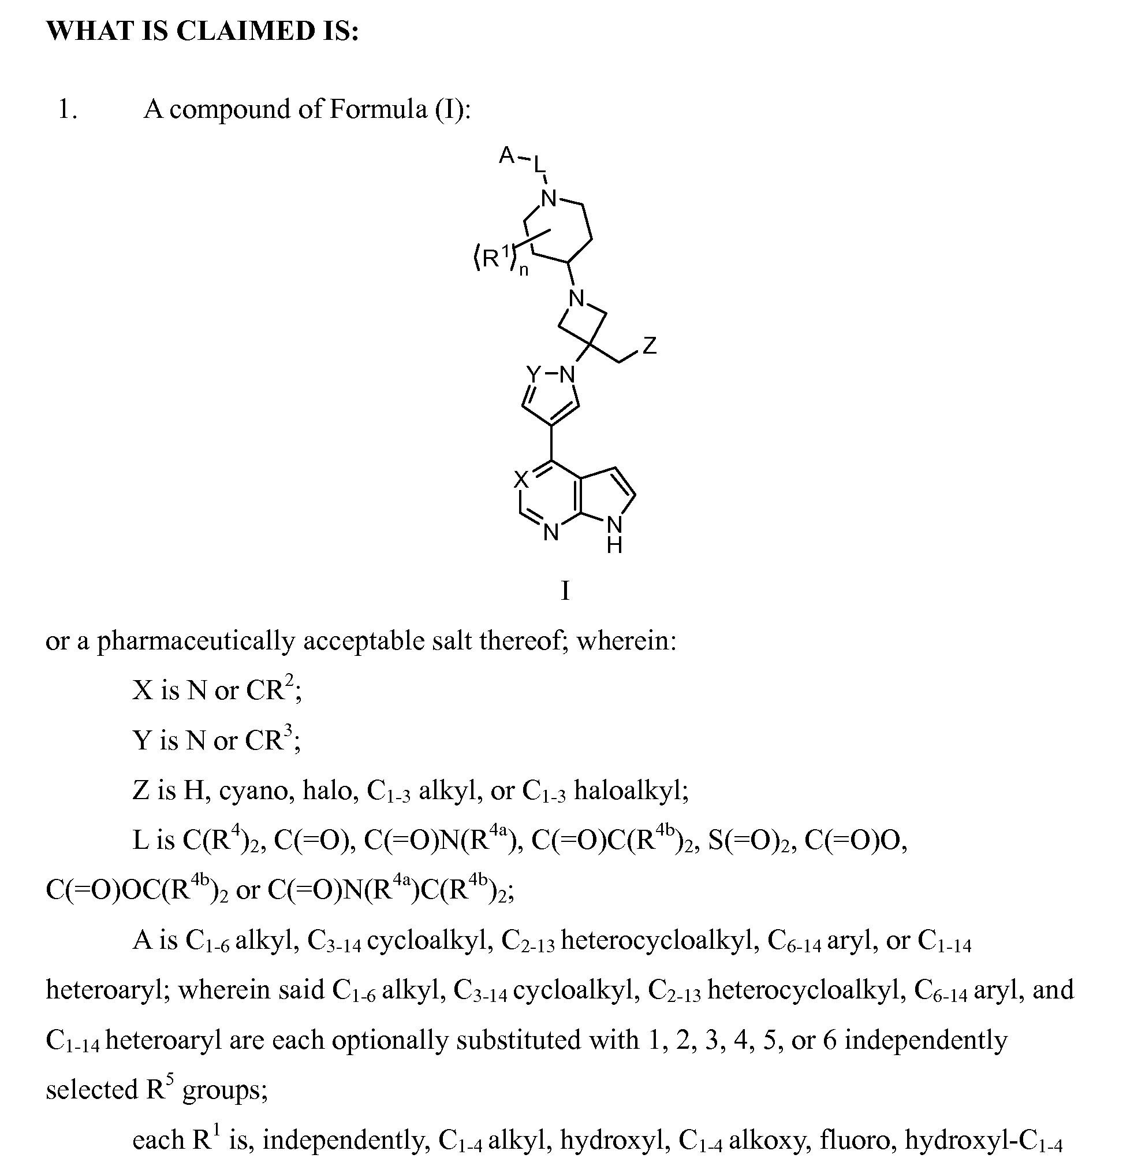
Claim sample – as filed
WO2011112662A1

Slide 32
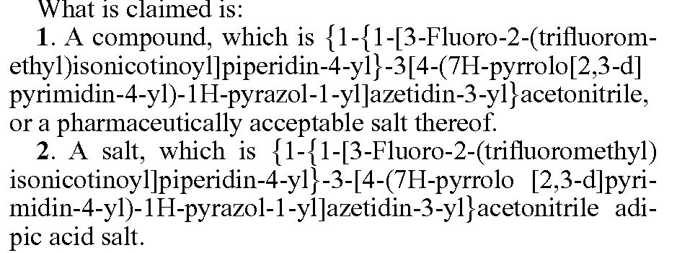
Claim sample – as granted
US8765734B2

Slide 33
Admissible claim amendments
Applicant may usually amend/narrow claims anytime during examination, e.g. if originally filed claims are not patentable:
Adding further features taken from description or other claims
Replacement of features
Completely reworded claims
All features have to be supported by the original description
Features from drawings not supported by the description are not permitted, i.e. they have to be mentioned explicitly in description
Examiner to check whether amended claims are within initial disclosure
Article x

Slide 34
Drafting claims
Do not
  include process steps in product/device claims
  mention benefits, advantages, alleged positive effects
  mention the problem that was solved
  refer in a general way to the description or drawings (‘as shown in Fig. 1’)
  (include in the main claim optional features)
  use ambiguous expression (about, nearly, perfectly, almost,…)
Do
  Include in main claim only essential features but all essential features to solve the problem, to achieve the benefits, advantages of the invention
  Refer to elements in drawings by using reference numerals in brackets
Notes:
34

Slide 35
Samples
What’s wrong with the following claim?
An apparatus for harvesting corn, comprising:
a thrasher for cutting corn;
moving the cut corn into a hopper; and
a rotating pivot attached to the thrasher.

Slide 36
Samples
What’s wrong with the following claim?
An apparatus for harvesting corn, comprising:
a thrasher for cutting corn;
moving the cut corn into a hopper; and
a rotating pivot attached to the thrasher.
Process step!

Slide 37
Thank you lutz.mailander@wipo.int

