Slide 1
Topic 2A: Substantive Patent Examination
Lutz Mailänder
Head, International Cooperation on Examination and Training Section
Teheran
Deember 17, 2019

Slide 2
Legal basis of patent examination
► Patent law/act (issued by parliament, i.e. legislative body)
► Patent rules/regulations/ordinances (issued by minister, commissioner/…, i.e. administrative body)
► International treaties (Paris Convention, PCT, TRIPS...)
require interpretation
► Case law (interpretation by court rulings)
► Examination guidelines (referring to essential CL)
Notes:
Legislative foundations are very similar.
Case law differs from legislation to legislation and is major reason for differing patent prosecution practices.
Paris convention will be addressed repeatedly later, eg this presentation or ppt on families

Slide 3
Examination Guidelines/Manuals
►EPO Guidelines
English: http://www.epo.org/law-practice/legal-texts/guidelines.html
http://documents.epo.org/projects/babylon/eponet.nsf/0/7ffc755ad943703dc12576f00054cacc/$FILE/guidelines_2010_complete_en.pdf
►PCT Examination Guidelines
http://www.wipo.int/export/sites/www/pct/en/texts/pdf/ispe.pdf
►German Guidelines (in English)
http://www.dpma.de/docs/service/formulare_eng/patent_eng/4/p2796_1.pdf
►Indian Manual (draft)
http://ipindia.nic.in/ipr/patent/DraftPatent_Manual_2008.pdf
http://ipindia.nic.in/PatentOfficeProcedure/PatentOfficeProcedure_2009.pdf
►USPTO Guidelines
http://www.uspto.gov/web/offices/pac/mpep/documents/2100.htm
Notes:
Add online resources for case law

Slide 4

Requirements of patentability
Substantive patent examination has to check
  Novelty (6)
  Inventive step (obviousness) (7) Article 2
  Industrial applicability (5)
  Unity (2) Article 8
  Technical nature (3) Article 2
  No case of exclusion (4) Article 4
  Sufficient disclosure Article 6 (c)
  Legal certainty of claims (clarity) (1) Article 6 (c)
  Additions to initial disclosure (8) Article 8 (a)
  Deposit of novel micro-organisms none
  Disclosure of origin of genetic resources none
Notes:
Unity is more a formal requirement to prevent abuse of the office resources.
4

Slide 5
Differences of national patent legislations
Basic categories of requirements are the same in most jurisdictions (unity, novelty, inventive step, technical nature, sufficient disclosure)
Some differences exist in how the term "invention" or "patentable invention" is defined (positively, negatively)
Differences, however exist mostly in terms of exclusions, e.g.
  US do grant business methods, software patents,..
  DE/EP grants new use of known compound, PK does not,..
  Islamic countries exclude, e.g., inventions not compatible with Sharia
  Temporary exclusions in Myanmar: section 8 (b)
For analysis, see e.g. SCP studies on WIPO website:
  http://www.wipo.int/edocs/mdocs/scp/en/scp_13/scp_13_3.pdf

Slide 6
Differences of national patent legislations
Paris Convention and PCT treaty do not address exclusions from patentability
  PCT permits ISA to exclude certain subject matter from search
TRIPS permits exclusions of certain subject matter
Further important differences exist in case law, e.g.
  Technical nature of software related patents
  Inventive step
Further important differences exist with respect to limitations of the rights of the owner of a granted patent, e.g. the research privilege

Slide 7
Overview of pre-grant prosecution
Filing
Check basic requirements
Obvious Defects ?
Formal Examination
Publication of Application
Request for Examination ?
Substantive Examination
Decision to grant/refuse
Publication of Grant

Slide 8
Elements of pre-grant prosecution
Filing
Date of receipt
Check basic requirements
Art. 11: Applicant‘s + identity?
Description?
Request for grant of patent?
Invite corrections
Valid application
Initial disclosure is fixed (Art 8a)
Classification
Filing date
Determines prior art !
18 months
PCT national phase entries:
Filing date = PCT filing date
Different if priorities are claimed
Publication if no prior rejection

Slide 9
Elements of pre-grant prosecution
Filing
Technical Examiner
Check basic requirements
Technical nature ?
Unity ?
Excluded from Patentability ?
Industrial Applicability ?
Valid application
Obvious Defects ?
Formal Examination
Priority ok ?
Title clear ?
Abstract submitted ?
Claims ?
Proper Drawings ?
Designation of Inventor ?
Formality Examiner
Invite corrections
18 months publication
DE, EP: even with defects,
unless rejected, abandoned
Rejection of application

Slide 10
Elements of pre-grant prosecution
Filing
Some legislations only have registration after formality examination
Formal Examination
Request for Examination ?
Basic requirements:
• Novelty
• Inventive Step
Substantive Examination
Decision to grant/refuse
Comparison with prior art
Search
by technical expert
Use of external results
Notes:
Topic of workshop is substantive examination, not formal examination
10

Slide 11
Novelty
Section 7 (b):
"An invention is new, if it is not anticipated by prior art"
Section 5 (1)(a):
Invention
Feature A
Feature B
Feature C
Feature D
"Has not been invented before" ?
Notes:
NB It is not enough that all features are known.

Slide 12
Prior Art
Section 7 (b) (1)
Prior art shall consist of everything disclosed to the public, anywhere in the world,
by publication in tangible form or by oral disclosure, by use or in any other way,
prior to the filing date or, where appropriate, the priority date, of the application claiming the invention.
Section 5 (2)(b):

Slide 13
Prior art / state of the art
PUBLIC !!
It is not enough that the information exists somewhere, eg within a company !
Disclosure made available to public by
written description
Examiners usually focus on written disclosure.
Other prior art is usually introduced by third parties, eg at opposition.
by use
State of
the art
oral description
Or in any other way, e.g.
accessible through file inspection

Slide 14
Prior art
Any information that is made available to the public until the application date or the priority date (if priority is acknowledged)
Prior art
Filing date
Prior art
Priority date
Filing date
Conditions apply !

Slide 15
Prior art – grace period
Many legislations grant to the inventor and applicant a grace period of 12 months for disclosures of her/his invention, e.g. scientific publications, presentations at conferences, fairs
I.e. after the disclosure, she/he has 12 months time to file for a patent
Don’t delay your patent application unduly!
Section 5 (2)(c)

Slide 16
Novelty
Document
Claim
Feature ...
Feature ...
Feature ...
Feature ...
Feature A
Feature B
Feature C
Feature D
Claimed subject matter is not novel if
  all features are known
  from a single piece of prior art, e.g. another patent
Notes:
NB It is not enough that all features are known somehow.

Slide 17
Checking novelty
► Compare claimed inventive subject matter (e.g. claim 1) individually with each prior art document
Invention
Feature A
Feature B
Feature C
Feature D
Document 1: A+B+C
novel
Document 2: A+B+D
novel
Document 3: A+B+C+D
not novel
more on searching prior art later on
Notes:
17
To defeat novelty, all features have to be known from at least one single other document.

Slide 18
Checking novelty (equivalent features)
► Compare claimed inventive subject matter (e.g. claim 1) individually with each prior art document
Invention
Feature A
Feature B
Feature C
Feature D
Document 1: A+B+C
novel
Document 3: A+B+D
novel
Document 4: A+B+C+D
not novel
Document 5: a+B+C+D
not novel
Expert: a = A
E.g.: A=“Tank”, a=“Container” or “Reservoir”
Notes:
18
To defeat novelty, all features have to be known from at least one single other document.

Slide 19
Checking novelty (implicit features)
► Compare claimed inventive subject matter (e.g. claim 1) individually with each prior art document
Invention
Feature A
Feature B
Feature C
Feature D
Document 1: A+B+C
novel
Expert: C => D
not novel
E.g.: each bonding wire (C) ends at bonding pad (D)
each tank (C) has an inlet (D)
Notes:
19
To defeat novelty, all features have to be known from at least one single other document.

Slide 20
Checking inventive step
► If application is new: Is modification, e.g. of "closest" prior art obvious for someone skilled in the art ?
Invention
Feature A
Feature B
Feature C
Feature D
Document 1: A+B+C
novel
Document 2: A+B+C+F
novel
?
Difference to prior art 1, 2
A+B+C+D
Document 6: (D or F)
Notes:
20

Slide 21
Elements of pre-grant prosecution
Filing
Check basic requirements
Valid application
Further requirements:
Formal Examination
Unity
Technical nature
Exemptions
• Sufficient disclosure
Clear claims > legal certainty
No additions to initial disclosure, e.g. through amendments
Examination request
Substantive Examination
Third party observations
Amendments/Divisions
Decision to grant/refuse

Slide 22
Actions and communications
Search and examination report by examiner
with or without proposal for patentable claims
Included in file wrapper
Accessible through file inspection
Applicant's reply or withdrawal
with or without proposal for amended claims
Examiner to check: - whether amended claims are within initial disclosure
- whether claims are properly worded
Top-up search if amended claims include features disclosed only in initial description and not in searched claims
If no withdrawal
Examiner to reject with detailed reasoning
Examiner to grant and check publication (nothing added to initial disclosure)
Notes:
di

Slide 23
Evolution of claims
Claims of a patent application are usually different at different publication and prosecution stages of the application
Before examination, the initially filed independent claims in applications have a broader scope because applicants seek to get as much protection as possible
Claims of granted patents are, in comparison to the initially filed claims,
  Usually narrower, i.e. include additional features, or
  May be totally different
Claims after opposition have often narrower scope than claims after grant
Notes:
Add something on differences between IPOs' pratice regarding claims. Essential and formal differences of claims granted.

Slide 24
Claim sample – as filed
1. A method of determining the torque induced in a rotating shaft (51),
A the shaft (51) having a torsional oscillation frequency that is dependent on the stiffness of the shaft (51),
B where the torsional oscillation frequency and the stiffness are dependent upon the operating conditions of the shaft (51),
characterized in that
C the torsional oscillation frequency of the rotating shaft (51) is measured (35);
D the twist induced in the rotating shaft (51) by the torque is measured (39); and
E the measured value of the torsional oscillation frequency and the measured value of the induced twist are used (41) to determine the torque induced in the shaft (51).
EP2006651A2
Notes:
One part claim

Slide 25
Claim sample – as granted
1. A method of determining the torque induced in a rotating shaft (51),
A the shaft (51) having a torsional oscillation frequency that is dependent on the stiffness of the shaft (51),
B where the torsional oscillation frequency and the stiffness are dependent upon the operating conditions of the shaft (51),
the method comprising:
C measuring (35) the torsional oscillation frequency of the rotating shaft (51);
D measuring (39) the twist induced in the rotating shaft (51) by the torque; and
E using (41) the measured value of the torsional oscillation frequency and the measured value of the induced twist to determine the torque induced in the shaft (51);
F the torsional oscillation frequency of the shaft (51) and the induced twist are measured (35) at the second set of operating conditions;
the method is characterized by
G determining the torsional oscillation frequency of the shaft (51) at a second set of operating conditions at which the stiffness of the shaft (51) can be determined (33) and
H determining the stiffness of the shaft (51) at the second set of operating conditions;
I the torque induced in the shaft (51) at the first set of operating conditions is determined (41) using the measured torsional oscillation frequency and the induced twist at the first set of operating conditions, and the measured torsional oscillation frequency and the stiffness at the second set of operating conditions
Added during examination
EP2006651B1

Slide 26
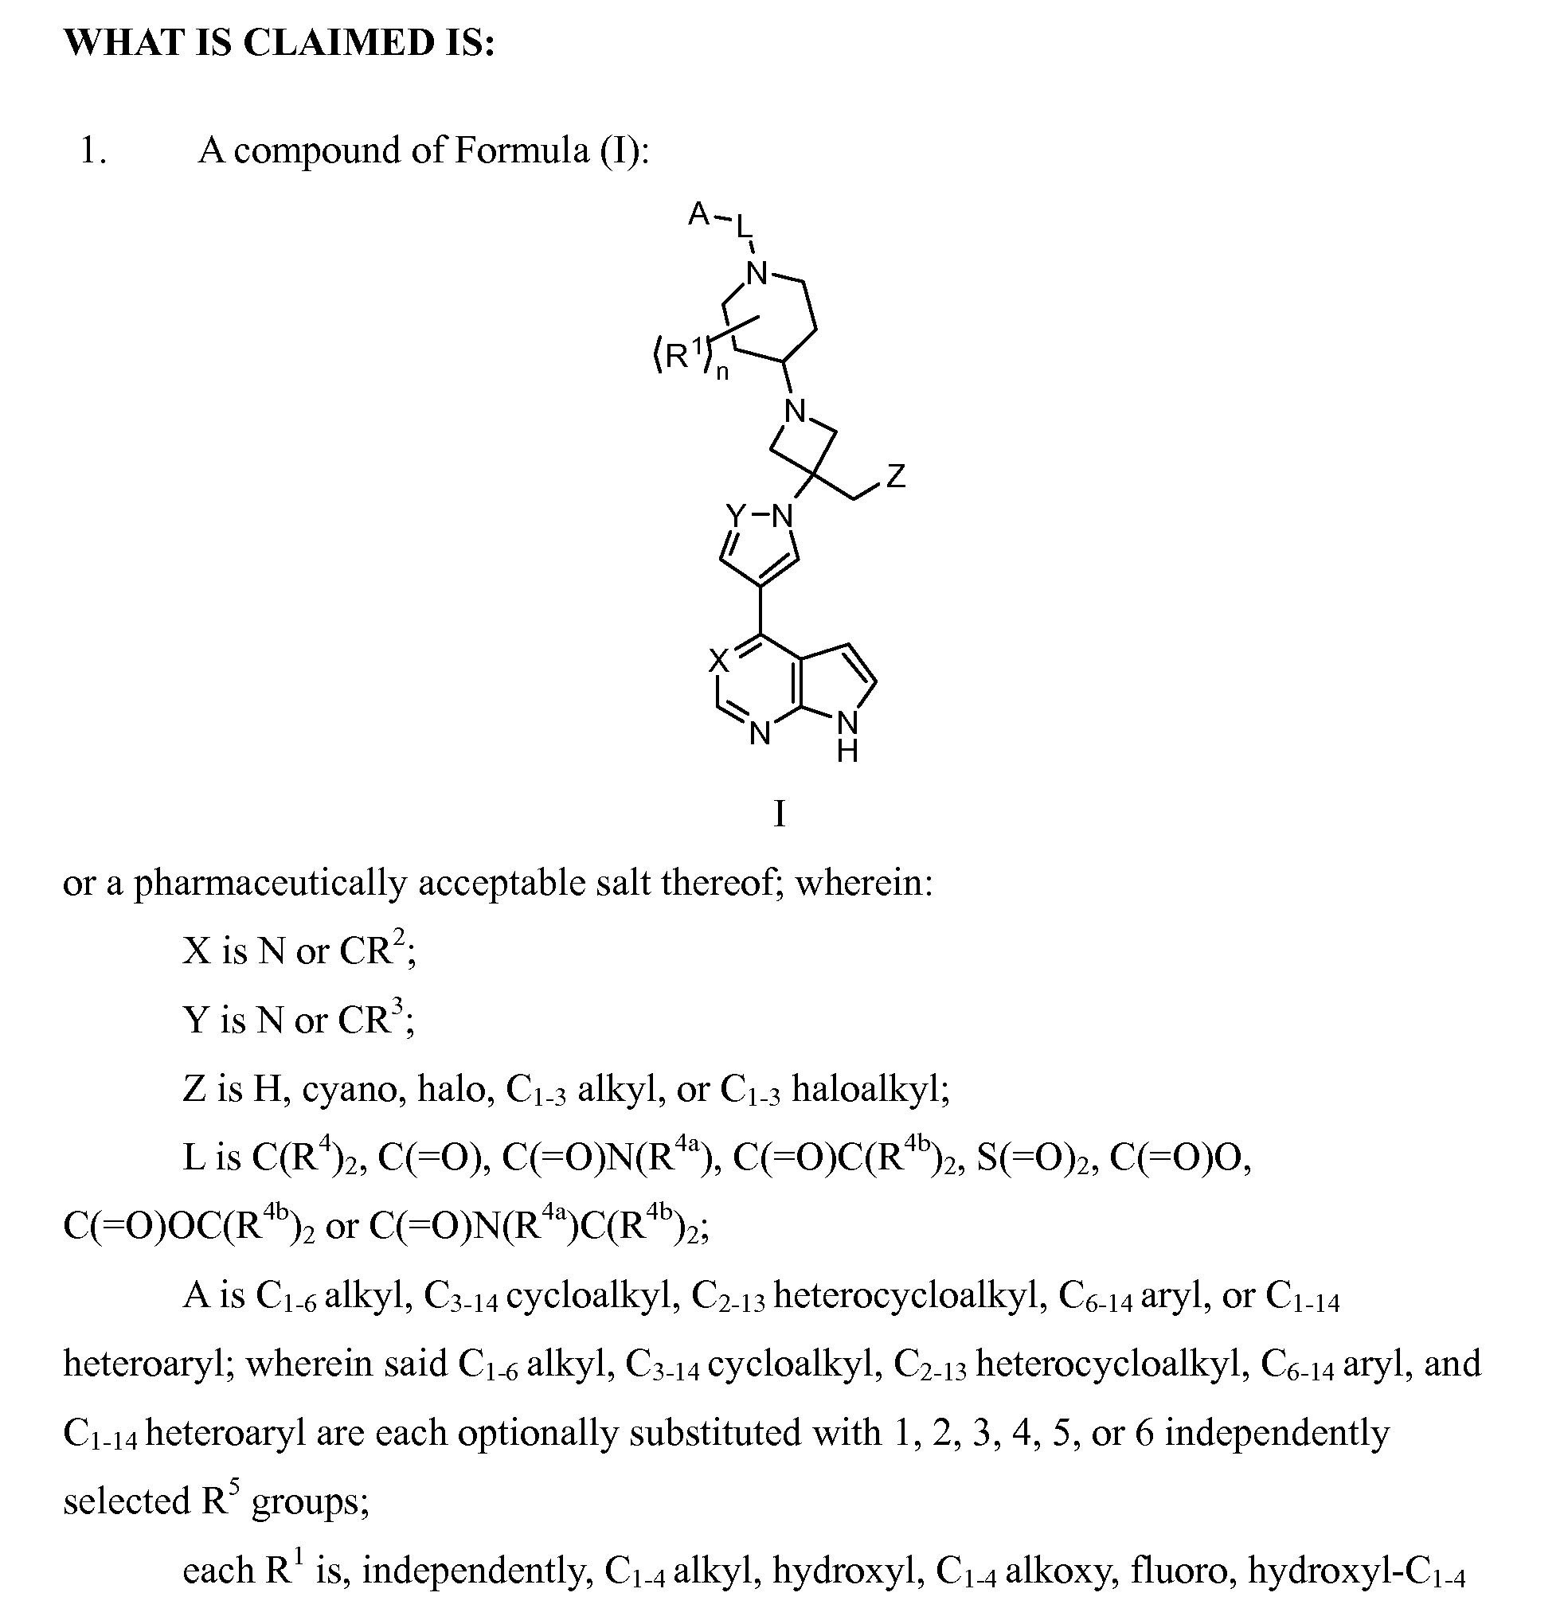
Claim sample – as filed
WO2011112662A1

Slide 27
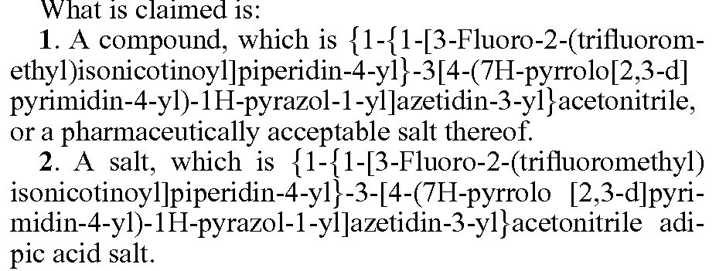
Claim sample – as granted
US8765734B2

Slide 28
Admissible claim amendments
Applicant may usually amend/narrow claims anytime during examination, e.g. if originally filed claims are not patentable:
Adding further features taken from description or other claims
Replacement of features
Completely reworded claims
All features have to be supported by the original description
Features from drawings not supported by the description are not permitted, i.e. they have to be mentioned explicitly in description
Examiner to check whether amended claims are within initial disclosure
Article x

Slide 29
Elements of patent prosecution
Filing
Decisions by examiner
Obvious Defects ?
Rejection
Appeal
Formal Examination
Rejection
Appeal
Substantive Examination
Rejection
Appeal
Granting
Appeal
Opposition
Rejection
Appeal
Revocation
Rejection
Appeal
subject to higher instances

Slide 30
Sequence of examination
Substantive patent examination has to check
  Legal certainty of claims (clarity)
  Technical nature
  Unity
  No case of exclusion
  Industrial applicability
  Novelty
  Inventive step
  Sufficient disclosure
  Legal certainty of claims (clarity)
  Additions to initial disclosure
Should be checked before prior art search
Requires prior art search
Notes:
Unity is more a formal requirement to prevent abuse of the office resources.
30

Slide 31
Grant phase
In many jurisdictions, third parties are given the opportunity to file an opposition
E.g. for EPO up to 9 months after publication of grant
Examination may have overlooked certain relevant prior art, e.g. examiners focus on publications included in PCT minimum documentation
Opposition body decides whether grant is
  maintained
  modified
  revoked

Slide 32
Post grant phase
Parties facing infringement litigation can request revocation of patents
Court may revoke, maintain or partially maintain patent
Almost the same patentability requirements apply
  Except lack of unity
(If patent was obtained by fraud or misrepresentation or concealment of any prescribed significant information)

Slide 33
Procedural principles
Principle of party disposition
  Applicant determines beginning, end and extent of proceedings through requests
Applicant’s requests determine the extent of each proceeding
  Binding effect for examiner as to content and sequence of requests, e.g. examiner can grant only claims with wording that the applicant requests
  Examiner to decide either “Yes” or “No”
  Examiner cannot amend and grant the application without the consent of the applicant
Notes:
33
Families

Slide 34
Fundamental procedural principle
Right to be heard, fair trial
  Guaranteed by constitution, international treaties, European Human Rights Charta,..
  Adverse decisions like a rejection can only be based on reasons that
    were previously communicated to applicant, and
    if he has had an opportunity to respond to it (it is not necessary that he did respond) (Art. 58)
  Appeal to court against adverse decisions of the registrar (e.g. to reject)
Notes:
34
Families

Slide 35
Thank you lutz.mailander@wipo.int

Slide 36
Required examiner capacities
Patent examiner in major IPO
Dependent on application
Scientist / Engineer
Specific technical expertise in area of inventive subject matter
Legal Specialist
"State Patent Attorney"
Knowledge in patent law, regulations:
Novelty, Inventive Step, Claim Wording,...
Technical Generalist &
Legal Specialist
Patent Attorney
Independent of application
Notes:
Thesis: Like patent attorneys, that are generalists to some extent, examiners should be able to treat applications not only in their field of technical expertise. "State patent attorneys"
Extra slide?

